Slide 1
Switching Circuit & Logic Design
Lecture 23 : Register

Slide 2
Buffer Register

Slide 3
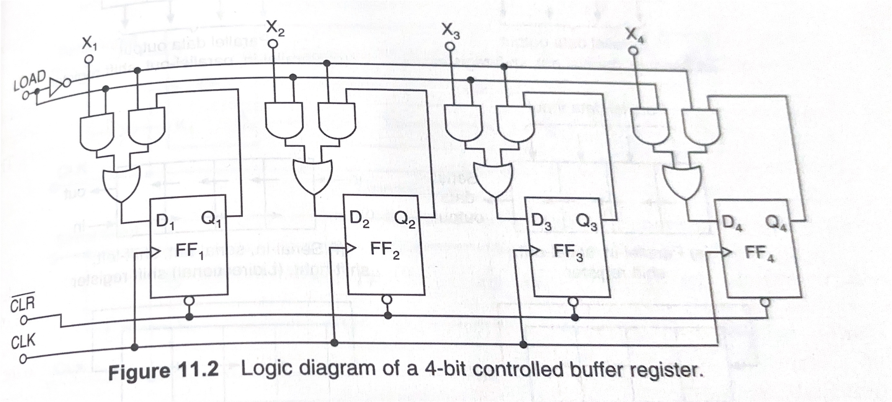
Controlled Buffer Register

Slide 4
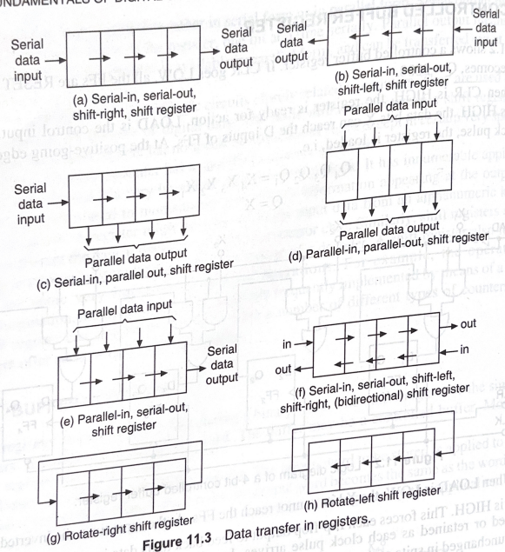
Data Transmission

Slide 5
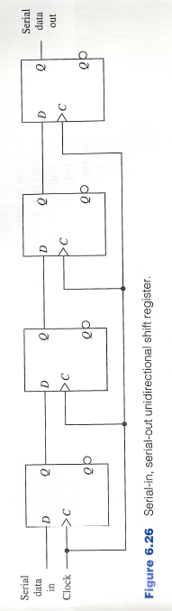
Serial-in Serial-out

Slide 6
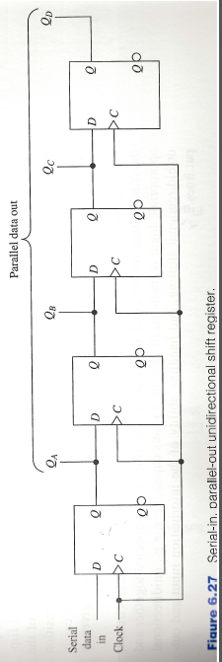
Serial-in Parallel-out

Slide 7
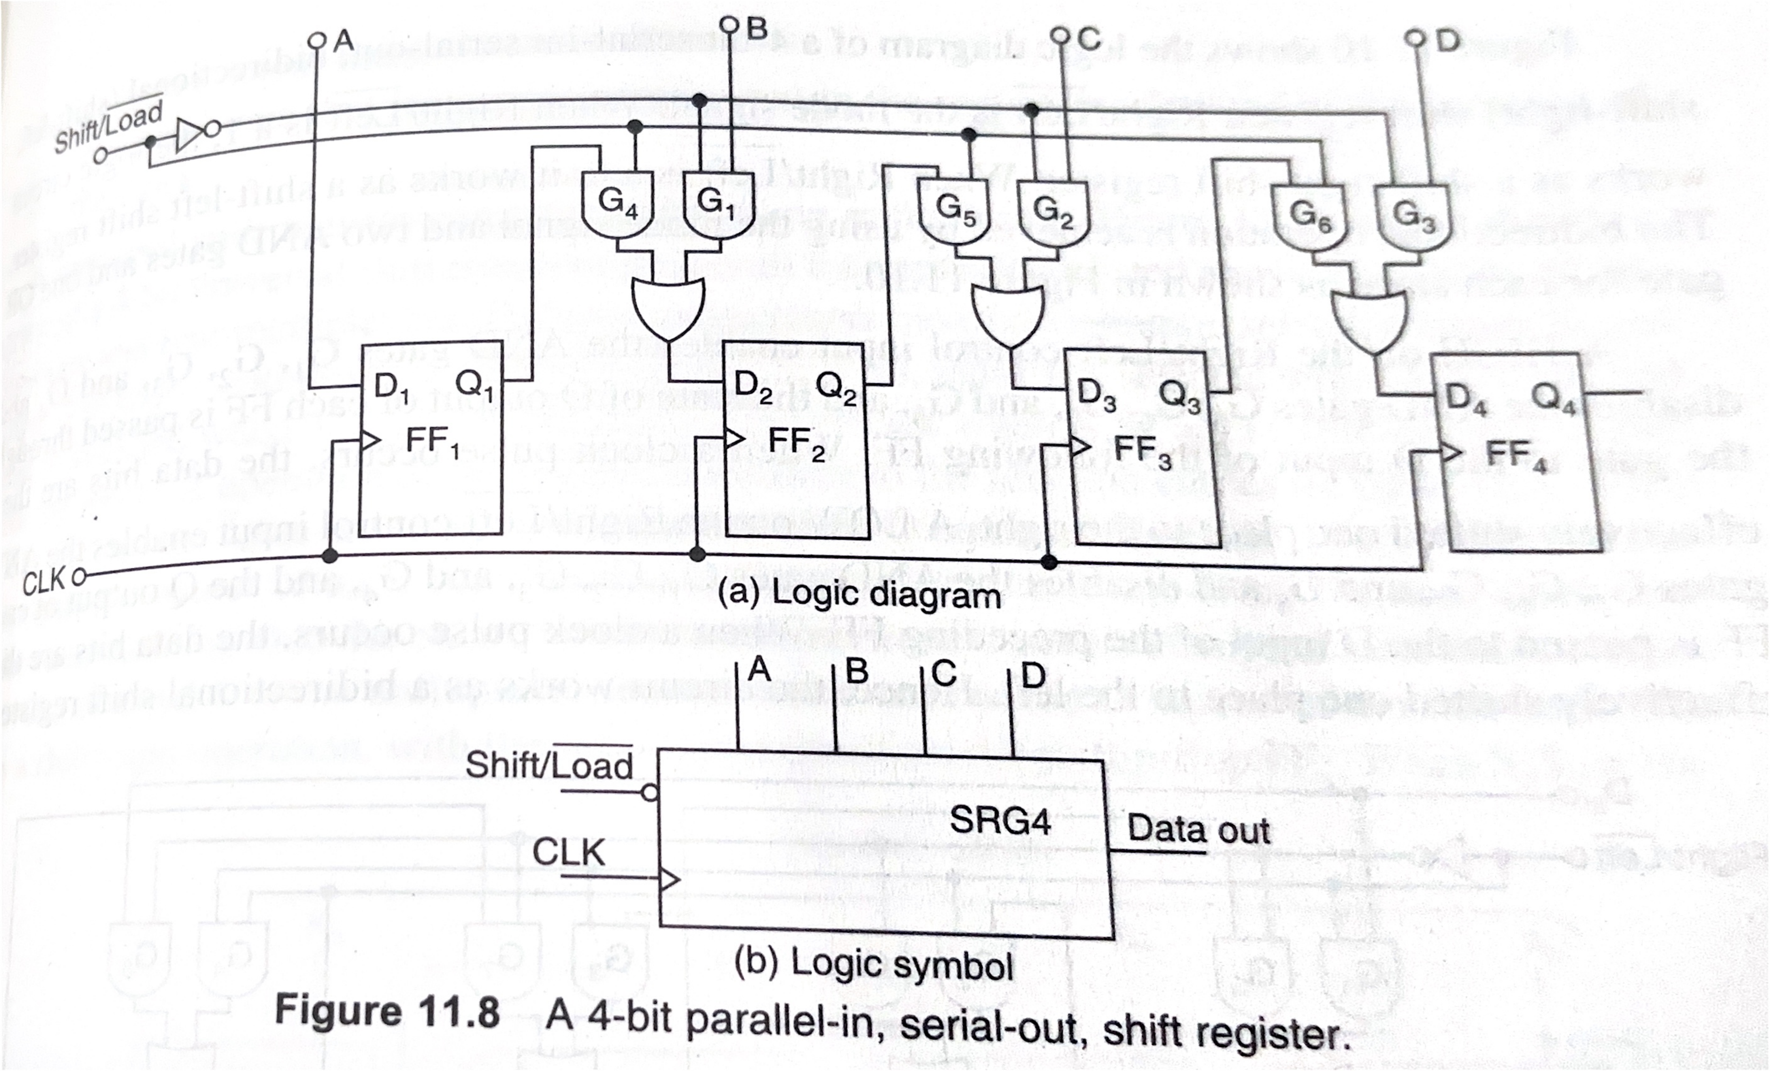
Parallel-in Serial-out

Slide 8
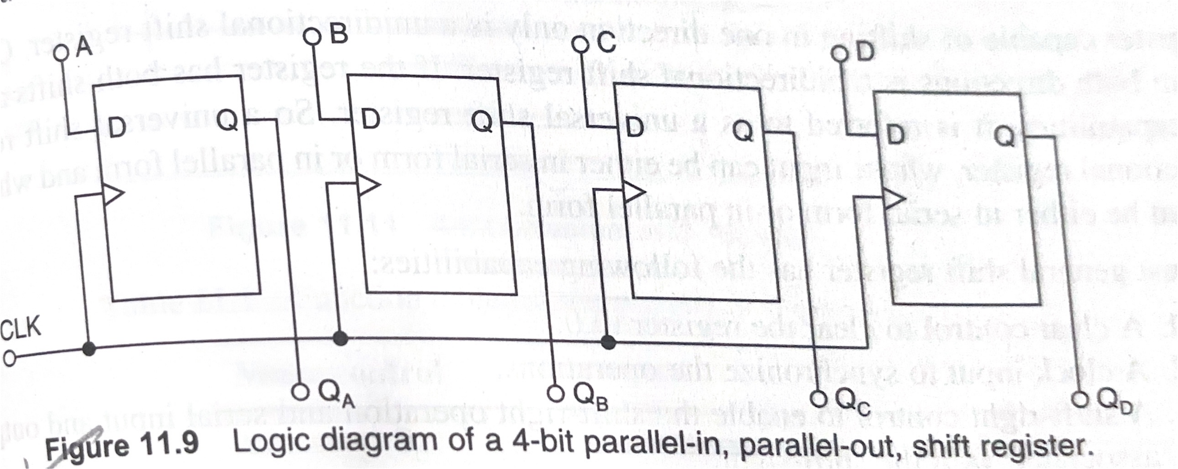
Parallel-in Parallel-out

Slide 9
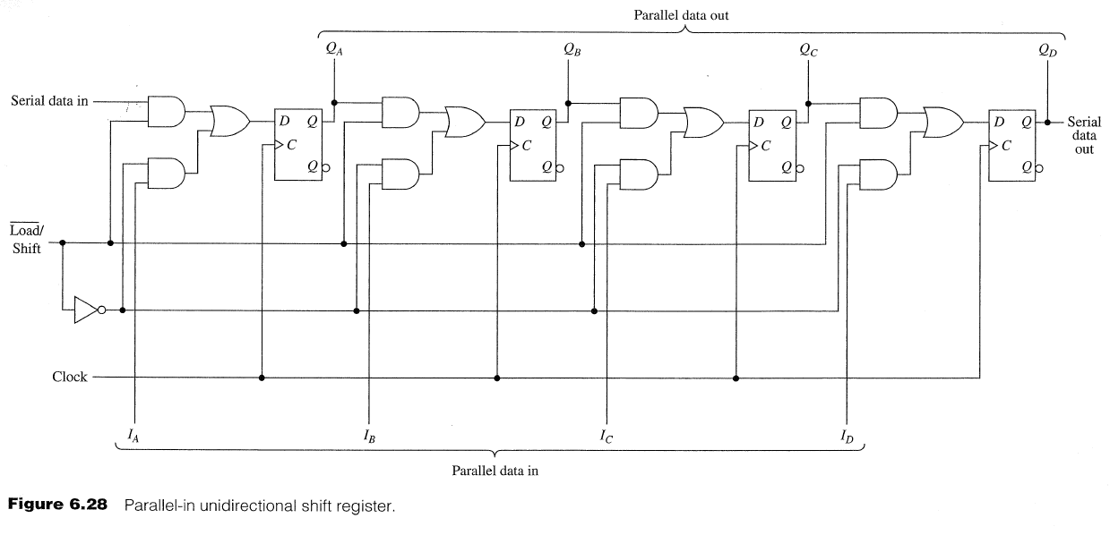
Bidirectional Shift Register

